Slide 1
Header Page

Slide 2
Social Media Glossary
Engagement: Number of times people have liked / shared our post.
Followers: Number of people subscribed to receive our posts.
Impressions: Number of times a tweet has been delivered to a particular account.
Mentions: Number of tweets that includes a reference to our username.
Reached: How many people have seen our posts.
Tweets: Number of tweets posted.
Sessions: Number of times the website has been visited.
Visits: Number of times users visited our profile page.

Slide 4
Facebook Results
 | Likes (COMMITMENT) | Reach (AWARENESS) | Engagement | Video Views
Jan
Feb
Mar
Apr
May
Jun
Jul
Aug
Sept
Oct
Nov
Dec

Slide 5
Monthly Tracking – right click on graph and select edit data

Slide 6
Facebook Audience Profile
Insert your data
(Note: Facebook Data – please allow for rounding up)

Slide 7
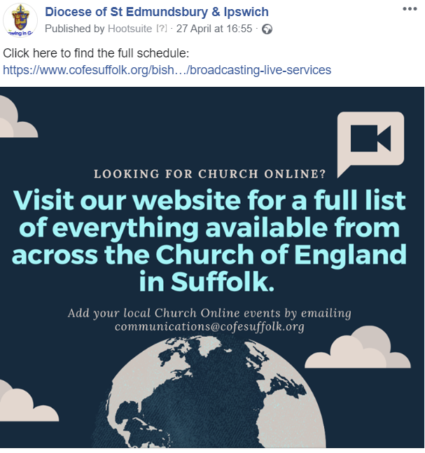
Top Facebook
Insert your top posts
Reached: 1178
Reached: 476
Reached: 838

Slide 9
Twitter Results
Diocese | No of Tweets | Profile Visits | Mentions | New followers | Total Followers | Impressions
Jan
Feb
Mar
Apr
May
Jun
Jul
Aug
Sep
Oct
Nov
Dec

Slide 11
Diocese | No of Followers | Reach – seen the photographs
Jan
Feb
Mar
Apr
May
Jun
Jul
Aug
Sep
Oct
Nov
Dec

