Slide 1
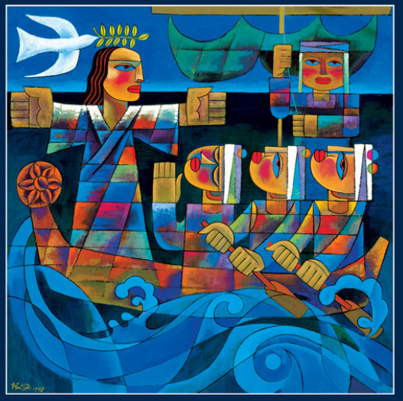
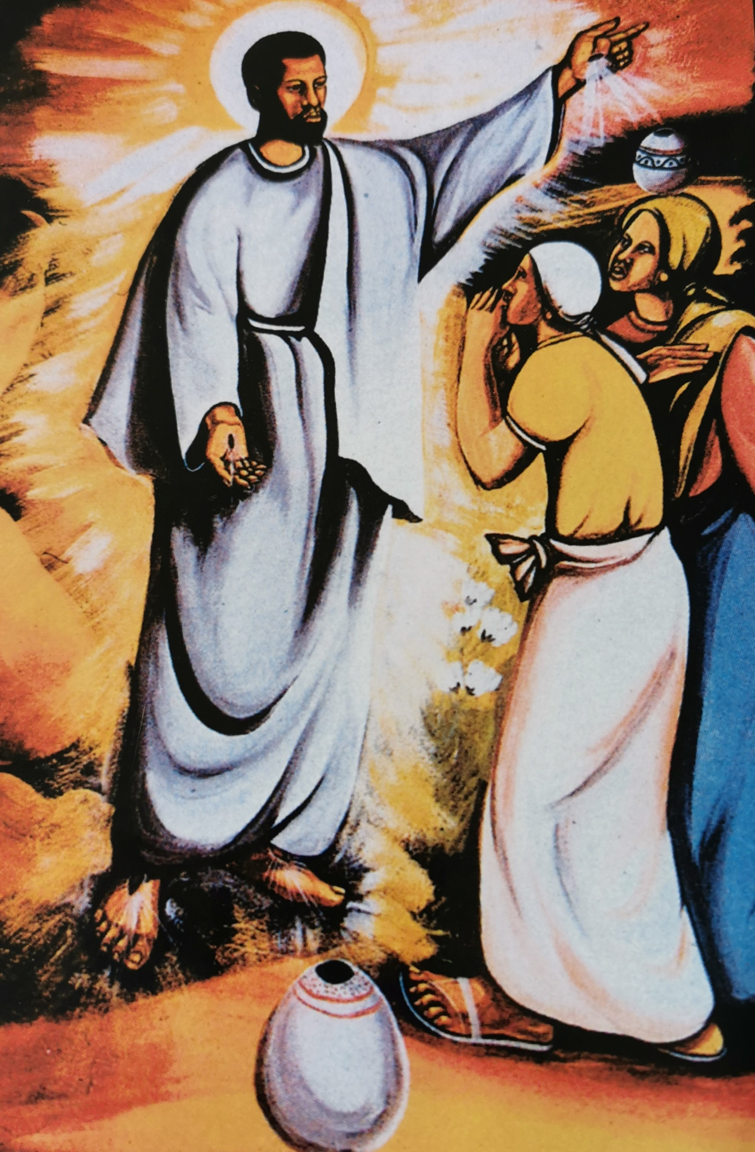
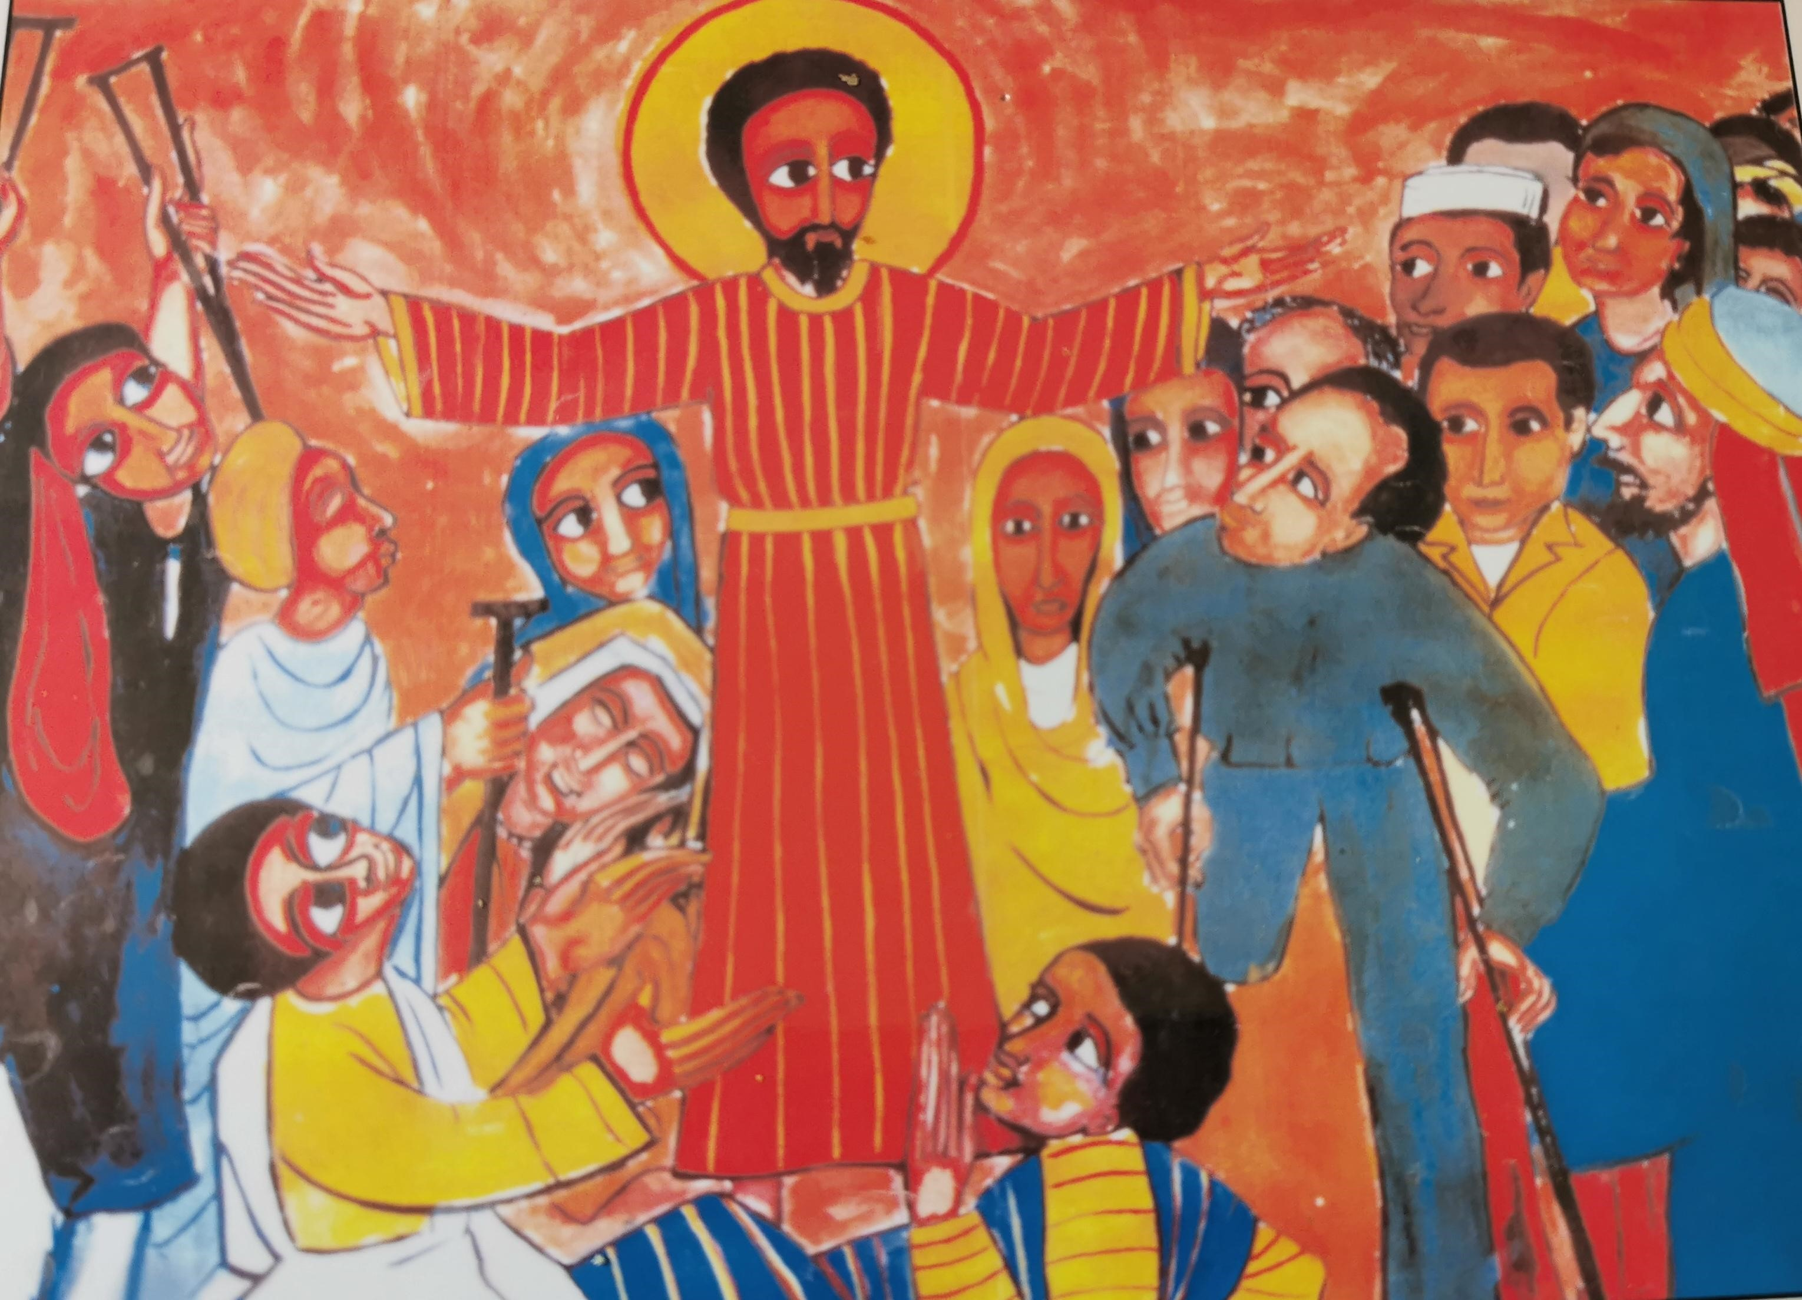
Jesus across the world
8 Collective Worships featuring diverse representations of Christ.

Slide 2
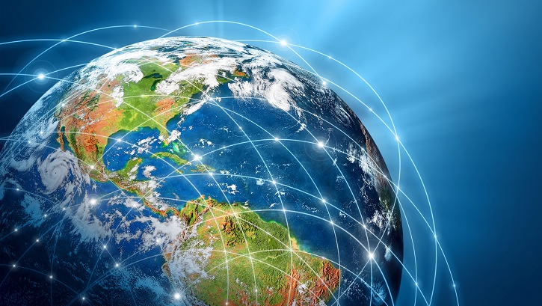
At the heart of Christianity is Jesus, and for pupils to understand what Jesus means to Christians they need to be familiar with accounts of his life and his teaching. As we look around the world, it becomes apparent that Jesus is interpreted through different cultures and portrayed in different ways. Ultimately, Jesus was a man we can all relate to and identify with who spoke of the needs of people and the right way to live.
We must avoid presenting limited stereotypical images of Jesus which fail to community the diverse living nature of Christianity worldwide.
*Each collective worship could be expanded to two sessions through watching a video of the bible story the day after – some good links included.
Introduction
Notes:
With thanks for the poster selection ‘Jesus Worldwide’ by the Christian Education Movement.

Slide 3
Worship #1

Slide 4
What is happening in the picture?
What does the Bible say?

Slide 5
Mark 4:36-41
Good News Translation
So they left the crowd; the disciples got into the boat in which Jesus was already sitting, and they took him with them. Other boats were there too. Suddenly a strong wind blew up, and the waves began to spill over into the boat, so that it was about to fill with water. Jesus was in the back of the boat, sleeping with his head on a pillow. The disciples woke him up and said, “Teacher, don't you care that we are about to die?”
Jesus stood up and commanded the wind, “Be quiet!” and he said to the waves, “Be still!” The wind died down, and there was a great calm. Then Jesus said to his disciples, “Why are you frightened? Do you still have no faith?”
But they were terribly afraid and began to say to one another, “Who is this man? Even the wind and the waves obey him!”
saddleback kids
What does this story tell us about why Jesus was special?

Slide 6
This painting is by Chinese artist He Qi. It is called Peace Be Still.
What does the dove remind you of? Can you link it to any other Bible stories?
What do you think the artist thinks about Jesus?
Jesus looks neither male nor female. Why do you think has he been painted like this?
Can you spot the praying disciple? Why was this important to include?

Slide 7
Time to think or time to pray…
This painting is of when Jesus calms the storm. The disciples are scared. I wonder what they were thinking at this moment? It is the disciple who is praying that gets the response from Jesus. He askes them why they are worried, and he seems genuinely surprised that they are so full of fear. He then stops the storm and the waters become peaceful once again.
Can you think of a time when you needed ‘peace through the storm?’
Christians believe we should trust that Jesus is there to help us when we are frightened. That he will be right beside us and that we are never alone.
Dear God, when I am afraid, please help me to put my trust in you instead of myself and to remember that you are always by my side. Amen.

Slide 8
Worship #2

Slide 9
What is happening in the picture?
What does the Bible say?

Slide 10
John 2
Good News Translation
Two days later there was a wedding in the town of Cana in Galilee. Jesus' mother was there, and Jesus and his disciples had also been invited to the wedding. When the wine had given out, Jesus' mother said to him, “They are out of wine.”
“You must not tell me what to do,” Jesus replied. “My time has not yet come.”
Jesus' mother then told the servants, “Do whatever he tells you.”
The Jews have rules about ritual washing, and for this purpose six stone water jars were there, each one large enough to hold between twenty and thirty gallons. Jesus said to the servants, “Fill these jars with water.” They filled them to the brim, and then he told them, “Now draw some water out and take it to the man in charge of the feast.” They took him the water, which now had turned into wine, and he tasted it. He did not know where this wine had come from (but, of course, the servants who had drawn out the water knew); so he called the bridegroom and said to him, “Everyone else serves the best wine first, and after the guests have drunk a lot, he serves the ordinary wine. But you have kept the best wine until now!”
Jesus performed this first miracle in Cana in Galilee; there he revealed his glory, and his disciples believed in him
Saddleback kids

Slide 11
How are people celebrating?
This is an African village celebration at first glance but a close look at the details reveals one of the miracles of Jesus.
Why can we see everyone’s face except for Jesus?
Where are the clues?
The artist visited areas in Cameroon, Africa to tell people about Jesus. The villagers then acted out the stories and the artist painted the scenes.
Can you spot the bride and groom?

Slide 12
Time to think or time to pray…
The Bible tells us that Jesus performed many miracles, and so people at the time began to realize that he was a very special person indeed. It seemed to them that God must be at work. When God is at work, everyday things like water can become very special. God can make ordinary things extraordinary. Though we are all ordinary people, God thinks we are wonderful and loves us very much. Christians believe that if we make time for God in our lives he will help us to change for the better, just as in the story where ordinary water was changed into the best wine.
Dear God, Thank you for being at work in our lives. Thank you for loving us. Help us to learn we can call on you for help when times get tough, and changes happen. Amen

Slide 13
Worship #3

Slide 14
What is happening in the picture?
What does the Bible say?

Slide 15
Mark 1
Jesus Heals Many People
Jesus and his disciples, including James and John, left the synagogue and went straight to the home of Simon and Andrew. Simon's mother-in-law was sick in bed with a fever, and as soon as Jesus arrived, he was told about her. He went to her, took her by the hand, and helped her up. The fever left her, and she began to wait on them.
After the sun had set and evening had come, people brought to Jesus all the sick. All the people of the town gathered in front of the house and Jesus healed many who were sick with all kinds of diseases.
Saddleback kids
What does this story tell us about why Jesus was special?

Slide 16
I wonder… how do you think people were feeling? What might they have witnessed?
This picture was painted by Alimayehu Bizuneh in Ethiopia
Why is Jesus pictured with his arms stretched out?
Why are the people there?
Choose 3 – what do you notice about their faces?
In what way is Jesus pictured differently from anyone else in the picture?
What kind of person does the artist think Jesus was?

Slide 17
Time to think or time to pray…
Jesus performed many miracles including healing and many came to him to be healed. God gave him the power to do amazing things to help people. The artist here has added many people around Jesus worshipping, praising and thanking him for curing them.
We may not have seen a miracle, but there are many things we witness every day to be thankful for. Some of them are pretty miraculous when we think about it – the sun rising and setting every day, the beauty of the natural world, the wonders of creation.
I wonder… what are you thankful for today?

Slide 18
Worship #4

Slide 19
What is happening in the picture?
What does the Bible say?

Slide 20
Matthew 28
After the Sabbath, as Sunday morning was dawning, Mary Magdalene and the other Mary went to look at the tomb. Suddenly there was a violent earthquake; an angel of the Lord came down from heaven, rolled the stone away, and sat on it. His appearance was like lightning, and his clothes were white as snow. The guards were so afraid that they trembled and became like dead men.
The angel spoke to the women. “You must not be afraid,” he said. “I know you are looking for Jesus, who was crucified. He is not here; he has been raised, just as he said. Come here and see the place where he was lying. Go quickly now, and tell his disciples, ‘He has been raised from death, and now he is going to Galilee ahead of you; there you will see him!’ Remember what I have told you.”
So they left the tomb in a hurry, afraid and yet filled with joy, and ran to tell his disciples.
Suddenly Jesus met them and said, “Peace be with you.” They came up to him, took hold of his feet, and worshiped him. “Do not be afraid,” Jesus said to them. “Go and tell my brothers to go to Galilee, and there they will see me.”

Slide 21
This picture was painted by George Nene an artist in Zimbabwe, southern Africa. It is called ‘The Risen Christ Reveals Himself to Two Women.’
How would you describe the women’s expressions and body language?
What about Jesus – what is he doing with his hands?
Why did Nene choose to portray Jesus as a African?
What has the artist got from the Bible text and what has he added?
Is it important in the story that Jesus appears first to two women rather than men?
What do you think the artist thinks of Jesus?

Slide 22
Time to think or time to pray…
In this picture we see Jesus back from the dead with the first witnesses – two women. They look both amazed and afraid all at the same time. Jesus stretches out his arm to send the women to tell their story, to share the good news about him.
I wonder what they were feeling at this time?
Dear God, thank you for the resurrection of your son Jesus. Give us the courage to speak as confidently and courageously as Mary did at times when we are amazed or afraid. Help us share the good news about you in our actions and words. Amen

Slide 23
Worship #5

Slide 24
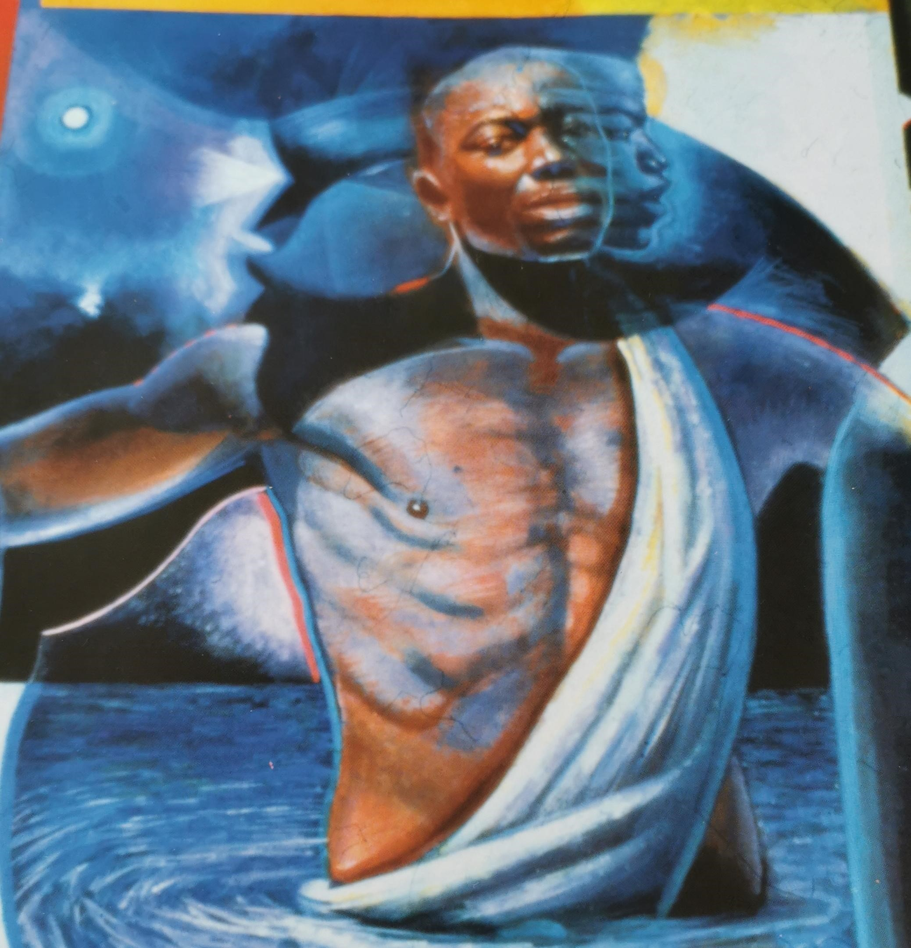
What is happening in the picture?
What does the Bible say?

Slide 25
Luke 3: 21- 23
The Baptism of Jesus
After all the people had been baptized, Jesus also was baptized. While he was praying, heaven was opened, and the Holy Spirit came down upon him in bodily form like a dove. And a voice came from heaven, “You are my own dear Son. I am pleased with you.”
Saddleback kids video
What does this story tell us about why Jesus was special?

Slide 26
This picture was painted by Pheoris West an artist in America. It is called ‘The Baptism of Christ.’
What do you like or dislike about this picture?
What sort of expression does Jesus have on his face here? What might his thoughts be?
What has the artist got from the Bible text and what has he added?
Look at the movement of Jesus’ face – what do you think that means?
People often remember Jesus as a member of their own race. Can you say why?

Slide 27
Time to think or time to pray…
This picture is of the time Jesus was baptized and his ministry and time of teaching began. Perhaps at this moment he looked to the future as Christians believe baptism is a time when your old life dies and your new life begins, where you turn to a new direction.
God calls us to be kind and generous, to share with others and forgive others and to try always to do what is right. God asks us to love our neighbour as ourselves. It is not easy, but in the same way that the Holy Spirit came to Jesus when he was baptised, the Spirit is there to help us when we find things difficult and to guide us to make the right choices.
Dear God, thank you for sending your spirit to guide us. Please help us make the right choices – to be kind and generous to others as Jesus was so that our thoughts and deeds please you. Amen

Slide 28
Worship #6

Slide 29
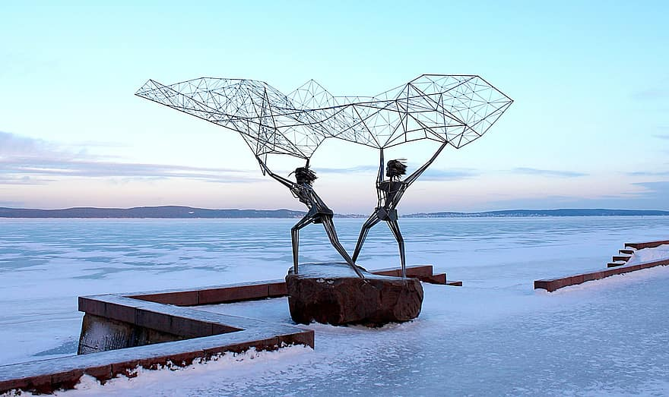
What is happening in the picture?
What is the link to the Bible?

Slide 30
Matthew 4:18-22
Jesus Calls Four Fishermen
As Jesus walked along the shore of Lake Galilee, he saw two brothers who were fishermen, Simon (called Peter) and his brother Andrew, catching fish in the lake with a net. Jesus said to them, “Come with me, and I will teach you to catch people.” At once they left their nets and went with him.
He went on and saw two other brothers, James and John, the sons of Zebedee. They were in their boat with their father Zebedee, getting their nets ready. Jesus called them, and at once they left the boat and their father, and went with him.
Saddleback kids
What does this story tell us about why Jesus was special?

Slide 31
This picture is of a sculpture called The Fishermen, Sculpture by Rafael Consuegra installed at Petrozavodsk, Russia
How does the sculpture make you feel?
Do you think it is a good choice of materials? How has he created a sense of movement?
Who do you think the figures represent? What are they getting ready to do?
What has the artist got from the Bible text and what has he added?
Who or what are the figures trying to catch?
What do you notice about the way the sculptor has planned his work?

Slide 32
Time to think or time to pray…
Jesus invites Peter and Andrew to become fishers of people. He simply tells them ‘Follow me’. For Peter and Andrew this meant that they had to leave their nets behind and follow Jesus on foot wherever he went. They left their jobs, they left their boat, they left their families, they left their plans, they left their friends… they left their old life behind.
Christians believe they are called to leave things behind as well like being selfish, unkind, greedy and unforgiving. Following Jesus means leaving certain things behind. These will be different for each of us.
I wonder… what bad habits should you leave behind?
Dear God, thank you for sending Jesus to show us the right way to live. Please give us the strength to leave our bad habits behind and become more and more like your son Jesus. Amen
?

Slide 33
Worship #7

Slide 34
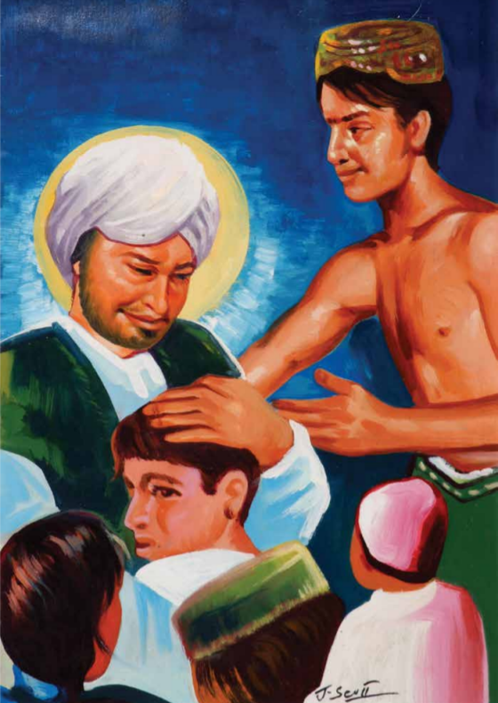
What is happening in the picture?
What does the Bible say?

Slide 35
Matthew 19:13-15
Good News Translation
Jesus Blesses Little Children
Some people brought children to Jesus for him to place his hands on them and to pray for them, but the disciples scolded the people. Jesus said, “Let the children come to me and do not stop them, because the Kingdom of heaven belongs to such as these.”
He placed his hands on them and then went away.
What does this story tell us about why Jesus was special?

Slide 36
This picture is called ‘Loving Jesus.’ It was created by Joseph a Punjabi artist who lived in Pakistan. It has been painted in the Punjabi culture, showing Punjabi dress.
Why do you think Jesus enjoyed the company of children?
What has the artist got from the Bible text and what has he added?
Who are the people in the painting?
Why are they there?
Why did people want to be near Jesus?

Slide 37
Time to think or time to pray…
After preaching to different crowds, Jesus was tired and sat down for a rest. Then some people brought children to Jesus to pray for them. The disciples scolded the people thinking children would disturb the tired Jesus. But Jesus understands and loves children. He saw spending time with them as important as healing the sick. He knew their worth.
Dear God, thank you that you know and love us, each and every one of us young or old. Help us share that love for one another so we all feel valued and important. Amen.

Slide 38
Worship #8

Slide 39
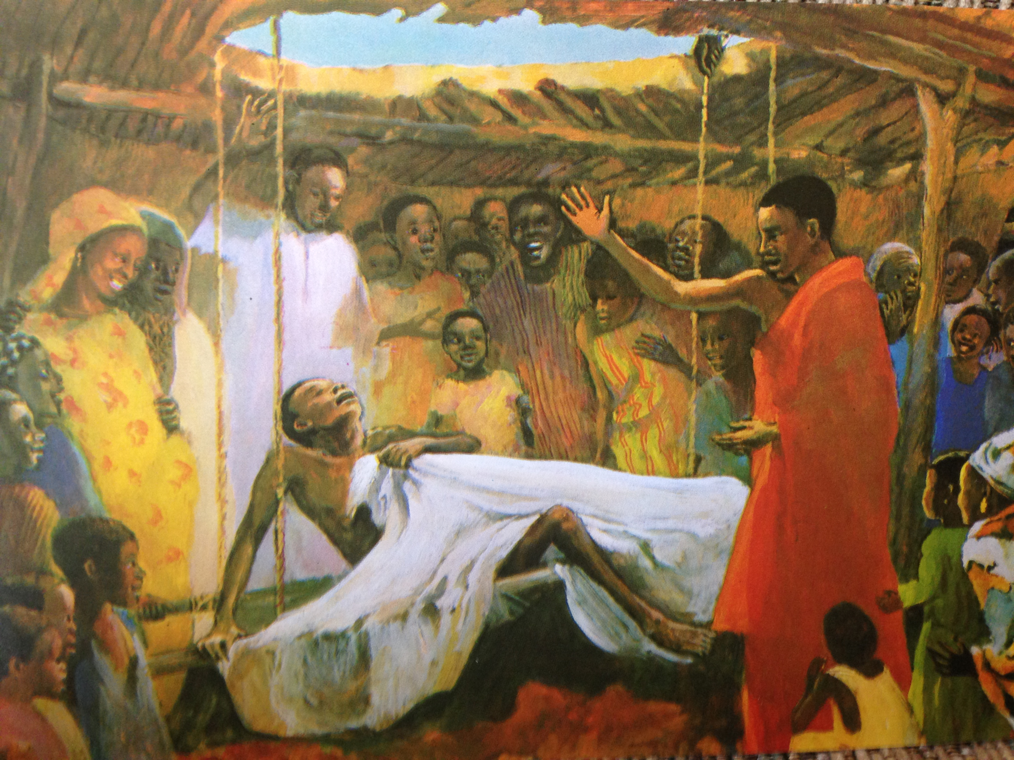
What is happening in the picture?
I wonder what the Bible says?

Slide 40
Mark 2:1-12 - Good News Translation
Jesus Heals a Paralyzed Man
A few days later Jesus went back to Capernaum, and the news spread that he was at home. So many people came together that there was no room left, not even out in front of the door. Jesus was preaching the message to them when four men arrived, carrying a paralyzed man to Jesus. Because of the crowd, however, they could not get the man to him. So they made a hole in the roof right above the place where Jesus was. When they had made an opening, they let the man down, lying on his mat. Seeing how much faith they had, Jesus said to the paralyzed man, “My son, your sins are forgiven.” Some teachers of the Law who were sitting there thought to themselves, “How does he dare talk like this? This is blasphemy! God is the only one who can forgive sins!” At once Jesus knew what they were thinking, so he said to them, “Why do you think such things? Is it easier to say to this paralyzed man, ‘Your sins are forgiven,’ or to say, ‘Get up, pick up your mat, and walk’? I will prove to you, then, that the Son of Man has authority on earth to forgive sins.” So he said to the paralyzed man, “I tell you, get up, pick up your mat, and go home!” While they all watched, the man got up, picked up his mat, and hurried away. They were all completely amazed and praised God, saying, “We have never seen anything like this!”
saddleback kids

Slide 41
This is another Jesus Mafa painting.
Can you find the four friends who lowered him down to Jesus?
What is about to happen?
What has the artist got from the Bible text and what has he added?
I wonder how it felt to watch this miracle?
Why were his friends so determined to get their friend to Jesus?

Slide 42
Time to think or time to pray…
At the time of Jesus, Jewish people believed that if your body was sick and ill it was because of all the bad things you had done. But Jesus forgave any sins this man had and healed his body not because of anything he did but because of the faith of his friends. He had four friends who cut through the roof of the house to get their friend to Jesus. Imagine the care as they walked him around the staircase along the side of the building. Imagine the effort to create a hole in the roof? Imagine how the man must have felt being lowered down having no idea what was about to happen? His friends really cared about him.
Our friends will experience times in their lives when they feel a bit stuck and where they need some help from others. Let us hope during these times to be the type of friend they need and the type of friend we would want.
Dear God, please help me be a good friend and think of others in their time of need. Amen

